Slide 1

御
MITSUE PROJECT
PHASE 0 · PRE-FOUNDATION · SEP 2026
A 25-YEAR INITIATIVE · 二十五年計画
A modest plan for a small village in the mountains.
奈良県御杖村 森林・分散型エネルギー・地域に根ざした小規模データセンター
"The forest our ancestors planted — powering the village they built."
先人が植えた森が、今、村に豊かさをもたらす。
01 / 12
FOREST · BIOMASS CHP · AI
Notes:
Good afternoon. Thank you for making time. I'm going to walk you through the Mitsue Project — a 25-year initiative in rural Japan. Twenty-five years is a long horizon, so I'll keep this short: about ten minutes. The very short version is on this slide: forest, EV power, and a tiny community-owned data center, all in one mountain village in Nara Prefecture. Three things that sound unrelated. They're not.

Slide 2
御
MITSUE PROJECT
§ 01 · THE SETTING
MITSUE VILLAGE · 奈良県御杖村
One vacant school building. One tired forest. One short list of ideas.
COORDINATES · 座標
34.4194° N 136.0511° E
POPULATION
SCHOOL RELOCATED
≈ 1,400
2020
Mitsue is a mountain village in Nara Prefecture. In 2021, the elementary school merged with the junior high and moved to a new building — the old building sits empty. The cedar plantations around it are old and unmanaged. The grid is fragile. None of this is unusual in rural Japan — that's the whole point.
FOREST COVER
PROJECT HORIZON
≈ 93%
25 yr
If a small, careful intervention works here, it should be copy-pasteable into a thousand other villages with the same pattern.
02 / 12
MITSUE.IT
RURAL REVITALIZATION, BUT QUIETLY.
Notes:
Mitsue Village sits in the mountains of Nara Prefecture. Population is shrinking. The elementary school closed. The cedar plantations around the village are aging. The grid is fragile. None of that is unique to Mitsue — that's actually the point. Whatever works here should work in a thousand other villages with the same pattern. We're in Phase 0: pre-foundation. No press, event. Just trust-building, charter drafting, and assembling the founding team.

Slide 3



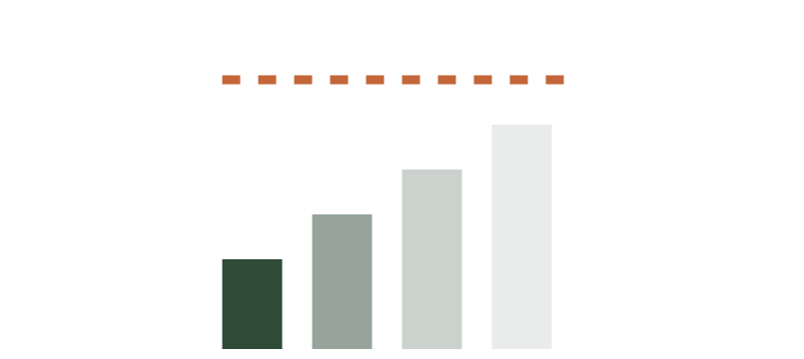
御
MITSUE PROJECT
§ 02 · FOUR PRESSURES, ONE RURAL ANSWER
Four expensive problems that turn out to be cheaper together.
四つの構造的圧力、ひとつの農村型解答
01 · ENERGY
02 · FOREST
03 · STRANDED
04 · DIGITAL
Japan targets 100% electrified new car sales by 2035.
Cedar is a liability — and a fuel.
Vacant village buildings just sit there.
Rural compute is thin.
In the EVs, PHEVs and FCVs — not pure-EV. Rural grids need distributed generation and charging; extension is slow and expensive.
Aged sugi plantations: pollen, biodiversity loss, landslide risk. Removing them powers the village; replacing them rebuilds the forest.
Vacant schools and factories cost shrinking municipalities money to maintain. Productive reuse turns them into community anchors.
Broadband and edge-compute capacity lag urban Japan. A small data center closes both gaps at once, on local power.
03 / 12
INDIVIDUALLY EXPENSIVE · JOINTLY ADDRESSABLE
Notes:
Four problems are converging on rural Japan at the same time. Cedar plantations are no longer managed — they cause pollen, biodiversity loss, landslides. The Japanese passenger cars will be electric soon, and rural grids aren't ready. Closed schools cost municipalities money to maintain. And rural broadband and edge compute lag the cities. Each problem alone is expensive. The Mitsue thesis is that they're cheaper to solve together than separately.

Slide 4
御
MITSUE PROJECT
§ 03 · THE IDEA
THREE ACTIVITIES · ONE COORDINATING BODY
Forest. Power. Compute. One ledger.
森林再生・分散型再生可能エネルギー・地域に根ざしたデータセンター — 一つの台帳で。
I
II
III
Forest restoration
Local energy + EV
Edge data center
Aged cedar → native broadleaf, on the ecological clock.
Sugi biomass CHP (the trees we remove) leads; solar and EV charging complement. Blackout resilience built in.
A small, community-rooted site — location under research.
04 / 12
EACH REINFORCES THE OTHER. MODEST IN SCALE, PATIENT IN HORIZON.
Notes:
So: three integrated activities under one coordinating body. Forest restoration. Distributed renewable energy and EV charging. A small, community-owned data center. The cedar we remove to make way for the native forest becomes the biomass that powers the data center and the cars — the conversion fuels the conversion. The data center anchors the closed school back into village life. They share a single 25-year ledger of methods, finances, and outcomes — published openly.

Slide 5


御
MITSUE PROJECT
I · FOREST RESTORATION · 森林再生
We feed the bears, so the bears stop visiting.
BEFORE · 杉人工林
Monoculture. Pollen. Quiet ground.
Phased replacement of aged sugi (cedar) plantations with native broadleaf — oak, chestnut, konara. Done with local landowners and the Forestry Agency. The 25-year arc is the ecological clock, not the funding cycle.
The sugi we remove doesn't go to waste — it fuels biomass CHP + the data center. That revenue funds higher landowner payouts and the co-op's mechanized equipment.
AFTER · 在来広葉樹
Broadleaf trees produce acorns and nuts that sustain deer, wild boar, and bear through winter. When the forest feeds them, they stay there — and out of the village vegetable patch.
Mixed canopy. Acorns. Deer eats here, not your daikon.
POLLEN
LANDSLIDE RISK
NATIVE CANOPY
↓ down
↓ down
↑ up
05 / 12
SUGI → BROADLEAF · 25-YEAR CYCLE · WILDLIFE BALANCE
Notes:
On forests: phased replacement of aged cedar with native broadleaf — oak, chestnut, konara. The 25-year arc is the ecological clock, not the funding cycle. The community benefit is concrete: less pollen, fewer landslides, a forest that looks and behaves like a forest again. Crucially, the cedar we remove doesn't go to waste — it becomes biomass fuel for the village's energy system. And when the broadleaf forest produces acorns, the bears, boar, and deer find their winter food in the forest instead of in the village vegetable patch.

Slide 6

御
MITSUE PROJECT
II · LOCAL ENERGY & EV · エネルギー
The forest powers the village. Lights stay on when the grid blinks.
The sugi we remove during forest restoration fuels a biomass CHP plant that powers a small compute site and EV chargers. We plan to scale in two stages: a ~50 kWe prototype first, then a full-scale CHP of about 1.2 MWe. Solar tops it up; the grid is backup.
06 / 12
SUGI BIOMASS · SOLAR · EV CHARGING · BLACKOUT RESILIENCE
Notes:
One unified electrical system. The sugi removed during the forest conversion is the primary fuel — a biomass plant on a shared village bus. Local solar tops it up. A community battery rides through the dark hours. The grid is backup only. EV chargers tie to local generation instead of waiting on grid extension. And — this is the part the village cares about most — on-site generation keeps the school, the clinic, and emergency facilities running through blackouts. Aging distribution lines make outages a real and growing risk. Resilience is built in, not bolted on.

Slide 7
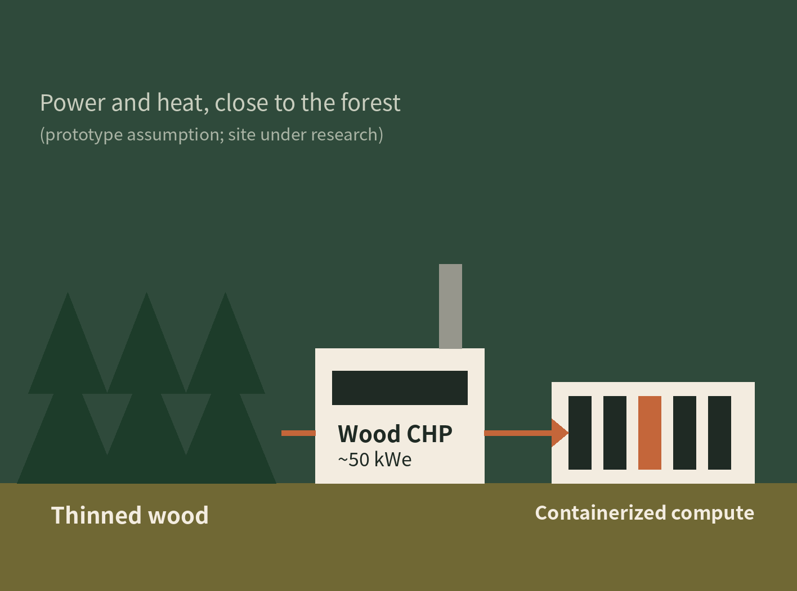
御
MITSUE PROJECT
III · COMMUNITY DATA CENTER · データセンター
A data center powered by the forest.
FROM FOREST TO COMPUTE
"A small data center powered by the forest."
"For the prototype, our current idea is a site belonging to the local forestry cooperative (not confirmed); the location of the full-scale plant is still being researched. It will be a small, energy-efficient edge-compute facility."
Sized for accountability, not hyperscale economics. Small enough for the community to audit and explain what it does. Heat re-use (e.g. drying, heating) is under consideration. Designed to be replicated by other depopulating municipalities — the blueprint is open.
SCALE
POWER
OPERATION
Edge
Wood CHP-led
Community-led
07 / 12
EDGE COMPUTE · HEAT RE-USE · REPLICABLE · PROGRESS + SUSTAINABILITY
Notes:
The closed school building or empty factory, repurposed as a small, energy-efficient edge-compute facility. Powered entirely by locally generated renewable energy. Sized for accountability — not hyperscale. The hyperscalers are not the model. The model is: small enough that the village owns it, audits it, and can explain what it does. Heat from the servers can warm greenhouses or community buildings. If it works in Mitsue, the design is published openly so the next village can copy it.

Slide 8
御
MITSUE PROJECT
§ 07 · BENEFITS — COMMUNITY & ENVIRONMENT
The win doesn't depend on the data center being a commercial hit.
Most benefits accrue to the village whether the compute side breaks even or not. That's the design.
COMMUNITY
ENVIRONMENT
BEYOND MITSUE
↳ Paid forestry work + co-op equipment upgrades
↳ EV charging for residents & visitors
↳ A new income stream from local resources
↳ Blackout-resilient clinic + comms
↳ Landowner payouts + a buyer for C/D-grade wood
↳ Native broadleaf returns at scale
↳ Cedar pollen burden goes down
↳ Wildlife pressure on farms drops
↳ Landslide risk reduces with age
↳ Local woody biomass as the main power source
↳ Methods + data published openly
↳ A replicable rural template
↳ CC-BY documents, open licences
↳ Designed to be copied, not franchised
↳ A bridge to small-scale fusion era
08 / 12
LOCAL FIRST · OPEN AND TRANSPARENT · PATIENT AND LONG-TERM
Notes:
This is the part I want you to remember. The benefits don't depend on the data center being a commercial home run. Forest restoration happens regardless. Wildlife pressure on farms drops. The school building stops bleeding maintenance money. EV charging is in place before the cars need it. Resilience to blackouts is a permanent infrastructure upgrade. The community keeps the upside; we documented everything; other villages get the playbook for free.

Slide 9
御
MITSUE PROJECT
§ 08 · WHERE WE ARE TODAY · SEP 2026
PHASE 0 · PRE-FOUNDATION · 準備期
✓ COMPLETED
Quiet on purpose. No press, no founder hoodies.
Initial meeting with Vice Mayor of Mitsue (late 2025)
Mitsue Kanko, local forestry partner, more trees/Tenkawa meetings (May–Aug 2026)
Founding charter, implementation & EVM plans drafted (BAC ¥220M)
GX地域共創 decarbonization subsidy inquiry submitted (Aug 2026)
Advisory board grown to 11, incl. 3 pro bono legal advisors
→ IN PROGRESS
Identifying a Japanese co-founder with rural credibility
Keeping the Village Mayor informed with project documents
Drafting bylaws for a 一般社団法人Mitsue-it
Engaging a 行政書士 (administrative scrivener) in Nara
Phase 0 is local trust-building, advisory-board building, and funding-track scouting. Self-funded, ¥0–0.25M. The work that matters right now is meetings, not announcements.
ADVISORY COMMITMENTS
◌ NEXT 30 DAYS
Ray Ozzie
Takuo Dome
Approach candidate Japanese co-founder
Continue quiet outreach with village hall
GX地域共創 Round 2 application (deadline Nov 30, 2026)
Prep NAIST seminar (confirmed, Jan 13, 2027)
Software pioneer · ex-Microsoft CSA
Professor, Osaka Univ. · Rep. Director, Inochi Forum
Henry Takata
Evin Zoet & Yoshiko Zoet-Suzuki
Rep. Director, SynTech Japan · biomass CHP
Co-Representative Directors, Transom
James Hill
Legal advisors (3)
Osaka Metropolitan Univ. · palaeoecology
Pro bono · entity structure & nonprofit law
09 / 12
PHASE 0 · MONTHS 01–06 · SELF-FUNDED
Notes:
Where we are today, September 2026. Phase 0, intentionally quiet. Meetings with the Vice Mayor, a local forestry partner, Mitsue Kanko, and more trees/Tenkawa are done. The charter, implementation plan, and EVM plan are drafted. A GX地域共創 decarbonization subsidy inquiry is submitted. The advisory board has grown to eleven, including three pro bono legal advisors — among them Ray Ozzie and Takuo Dome. We're keeping the Village Mayor informed by dropping off project documents, not holding a formal meeting, and a NAIST seminar is confirmed for January 13, 2027. Next: close the Japanese co-founder search, finalize the 一般社団法人Mitsue-it bylaws, and apply to the GX地域共創 Round 2 by November 30th.

Slide 10
御
MITSUE PROJECT
§ 09 · PHASES & GATES
Five phases. Four real funding gates.
Each gate is a checkpoint. Miss one and we hold and re-pitch — we don't accelerate into an under-resourced phase. The funding stack has five layers, deliberately, so no single source can stall the project early.
PHASE 0 · NOW
PHASE 1
PHASE 2
PHASE 3
PHASE 4
Pre-Foundation
Foundation
Pilot Design
Pilot Build
Operate & Scale
M 1–3 · ¥0.25M
M 4–9 · ¥5.5M
M 10–18 · ¥22.25M
M 19–30 · ¥177M
M 31+ · revenue-led
G1 · ¥3–8M
G2 · ¥30–50M
G3 · ¥120–290M
G4 · REVENUE ONLINE
FIVE-LAYER FUNDING STACK · TARGET ≈ ¥192M · ¥0 SECURED
SIX OPERATING PRINCIPLES
Layer
Source
Target
Secured
I. Local first
II. Open & transparent
L1
Founder / private
¥6M
¥0
III. Patient, long-term
IV. Replicable
L2
Government grants
¥115M
¥0
V. Modest in scale
VI. Non-partisan
L3
Foundations
¥33M
¥0
L4
Corporate partners
¥35M
¥0
L5
Operating revenue
¥3M
¥0
∑
Illustrative total
¥192M
¥0
10 / 12
25-YEAR HORIZON > ONE HYPE CYCLE
Notes:
Five phases, four explicit funding gates. If a gate isn't cleared, we hold and re-pitch — we don't accelerate into an under-resourced phase. The funding stack is five layers: founder capital, government grants, foundations, corporate partners, operating revenue. By Year 3 the illustrative total is around 134 million yen. These are planning targets, not commitments. The point of the gates is that we never bet the village on a phase we can't afford.

Slide 11
御
MITSUE PROJECT
§ 10 · VILLAGE RE PLAN
ALIGNMENT WITH THE VILLAGE'S RENEWABLE ENERGY PLAN
We don't ask the village to adopt a new idea. We run the plan it already wrote.
御杖村再エネ導入最大化計画（2025年・環境省補助）の官民連携 運営体制として実行します。
i
ii
iii
One resilient site
EV-charging priority
Forest J-Credit + 交付金
The plan targets one renewable + storage + EV resilient site (now zero). Our data center could be that site.
Transport = 46% of village emissions. We deliver the plan's priority EV charging at public facilities.
Biomass CHP supplies the forest-carbon/J-Credit mechanism. Unlocks the village-led 交付金: 2/3-3/4 subsidy on solar/battery/EV, via the village.
11 / 12
BIOMASS CHP STAYS PRIMARY · SOLAR/BATTERY/EV COMPLEMENTARY · FUNDING FLOWS THROUGH THE VILLAGE

Slide 12

御
MITSUE PROJECT
§ 11 · FOR PEOPLE WHO THINK IN DECADES
IF YOUR TIME HORIZON MATCHES OURS…
WHAT HELPS RIGHT NOW
↳ Introductions: Japanese co-founders with rural credibility
↳ Advisors: forestry, edge compute, Japanese nonprofit law
↳ Technical partners: small data-center operations & power design
↳ Honest critique — tell us where the thesis is wrong
We're looking for practical know-how, honest critique, and a few good neighbors.
SCAN TO VISIT
mitsue.it
codeberg.org / YR-Design / mitsue-ai-data-center
info@mitsue.it
PROJECT LEADER NOW
Rob Oudendijk
YR-Design · Safecast · Mitsue, Nara
12 / 12
THANK YOU · ありがとうございます
Notes:
What we're looking for from this room. Patient capital — people who think in decades, not quarters. Introductions to Japanese co-founders with rural credibility. Advisory partners for forestry, edge compute, and Japanese nonprofit law. And honest critique: tell us where the thesis is wrong. The documents are all on Codeberg under open licenses. The project lives at mitsue.it. Thank you — happy to take questions.

